Slide 1

Image Caption Generator
INSTITUTE OF ENGINEERING AND TECHNOLOGY LUCKNOW
Department of Computer Science and Engineering
Under Guidance of -:
Dr. Pawan Kumar Tiwari
Prof. Maheshwari Tripathi
Submitted By :-
Gaurav Pratap Singh(2000520139002)
Apoorv Jha (2000520139001)
Mradul Dixit (1900520130031)

Slide 2
Content
❏ Introduction
❏ Objective
❏ Motivation
❏ Methodology
❏ Working Procedure
❏ Software and Hardware Requirement
❏ Timeline graph
❏ Conclusion
❏ References

Slide 3
Introduction
Image caption generators automate the process of generating descriptive captions for images.
Image caption generators have applications in social media, e-commerce, and content creation industries.
Image caption generators make visual content more accessible for visually impaired individuals.
Deep learning techniques like CNNs and RNNs drive the accuracy of image caption generators.

Slide 4
Objective
The objective of this presentation is to introduce and explain the concept of image caption generators, their applications, underlying technologies, and impact on accessibility and content creation. For that, we developed a web application that can generate image descriptions.

Slide 5
Motivation
Image caption generator technology is currently utilized by multinational companies like Facebook and Google for advertising and other purposes.
Visually impaired individuals can benefit from this technology as it assists them in perceiving their surroundings.
It can be employed to create a digital security system that detects any unusual or suspicious activities.
Intelligent monitoring enabled by image caption generators can help prevent road accidents.
Optimizing social media posts for improved discoverability and reach.

Slide 6
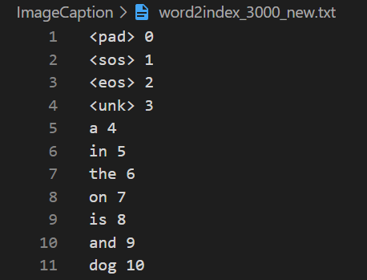
Methodology
Vocabulary
class Vocab( ):
build_vocab(vocab_size, file_name):
holding a counter for counting word occurences
predefined 4 tokens: <pad>, <sos>, <eos> and <unk>
to build the vocabulary split each line of text file into img_name and caption by the first comma separator and we change it to lowercase.
once we obtain the sentence, it is passed to method add_sentence.
most common words from the counter are used to build the dictionaries starting from index 5 (as first 4 indices are reserved for the predefined tokens)
add_sentence(sentence):
tokenize the sentence into words using regexptokenizer
update the counter with all the words from the sentence
vocab.py
6

Slide 7
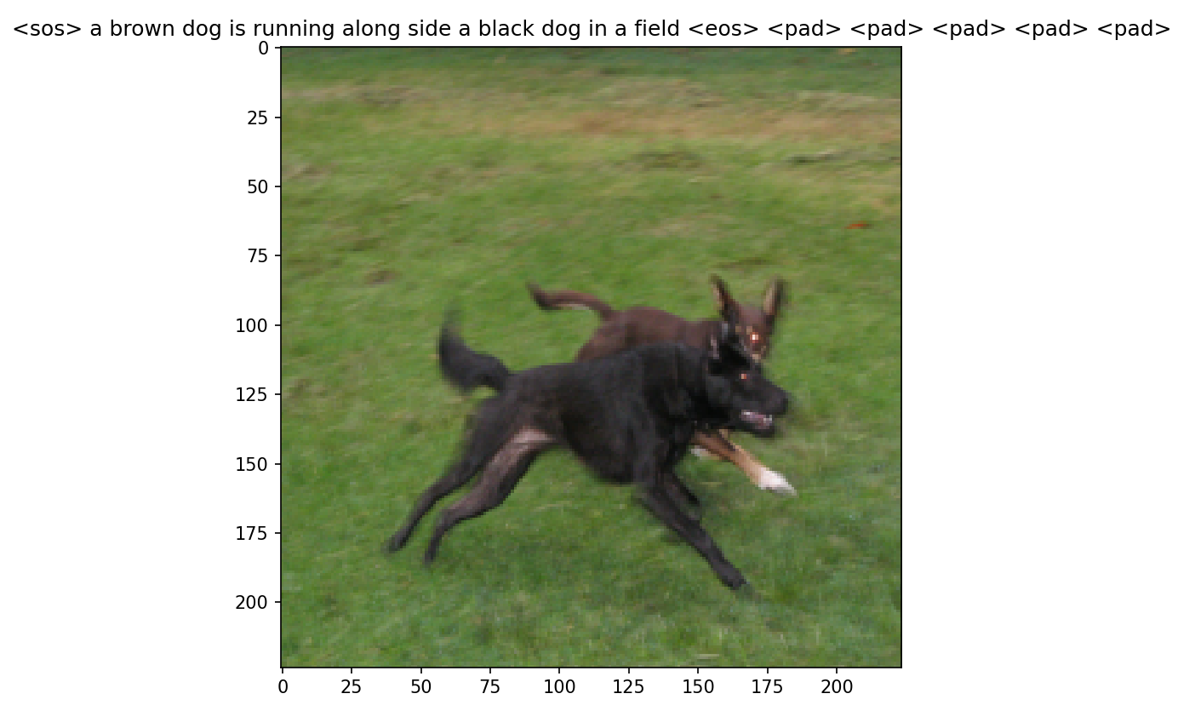
class ImageCaptionDataset( ):
holds a list of samples where each sample is a dictionary containing the image file id and caption of that image as a list of word indices (using the saved vocabulary)
caption is encoded by <sos> and <eos> token at the beginning and end of the caption respectively.
Get_data_loader( ):
returns DataLoader
performs padding on each caption in a batch according to the longest caption in batch where it belongs.
to reach the length of the longest caption in the batch we using Pad sequence
__getitem__( ):
using the image id a corresponding picture is loaded for the
sample image is further preprocessed – reshaped, cropped
transformed into a tensor
the image and its caption as list of word indices is returned
To think about…
dataset.py

Slide 8
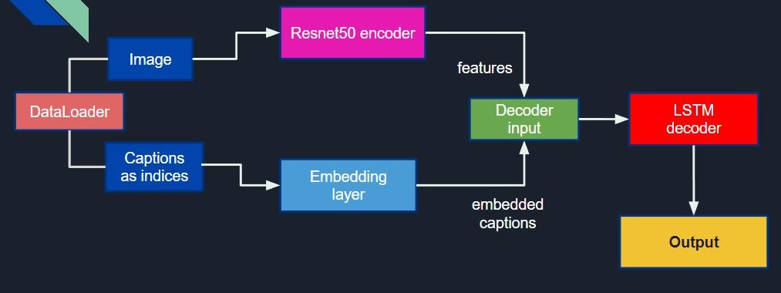
Working Procedure
model.py
8

Slide 9
Model
1. Encoder
2. Embedding layer
Image encoder to obtain features from images
Contains pretrained Resnet50 with last layer removed and a linear layer as final classifier
Used to obtain embedded representation (as a dense vector) of captions of dimension.
When training the model, the embedding layer is updated to learn better word representation through the optimization process.

Slide 10
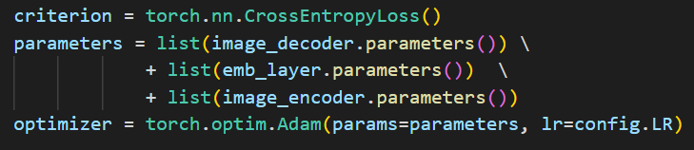
Model
3. Decoder
Other parameters for training the model
Contains LSTM layer and a linear layer as final classifier whose output is of dimension (VOCAB_SIZE).
The input for the LSTM layer is the combination of features from the encoder and the embedded captions from the embedding layer.
Hidden and cell states are initialized to zero.

Slide 11
Word generation (LSTM output)
Word-by-word generation
More traditional and commonly used
LSTM generates each word of the caption on at a time, based on the previous word (index), image features and hidden and cell states
it can potentially result in more diverse and interesting captions
However, this approach can be slower and more computationally expensive, especially if the length of the captions is long.

Slide 12
Model Training Implementation
As our dataset is divided into 2 files of images and their corresponding text, we first worked on image dataset.
Once pre-processed image and their corresponding captions we mapped image feature vector and their tokenized captions together.
This will help the model to learn vocabulary to predict and generate the captions.
Next we create architecture for our model, which is divided into 2 parts, image-model and language-model.
We then passed our pre-processed data to our architecture and train the model.

Slide 13
Software and Hardware Used
SOFTWARE Used -
Python
CUDA 9
TensorFlow, Keras, Numpy & Matplotlib
MACOS (X)
VS Code (IDE)
HARDWARE Used -
Powerful processor
Ample RAM (16GB+)
NVIDIA GPU
50 GB physical storage
Internet connectivity

Slide 14
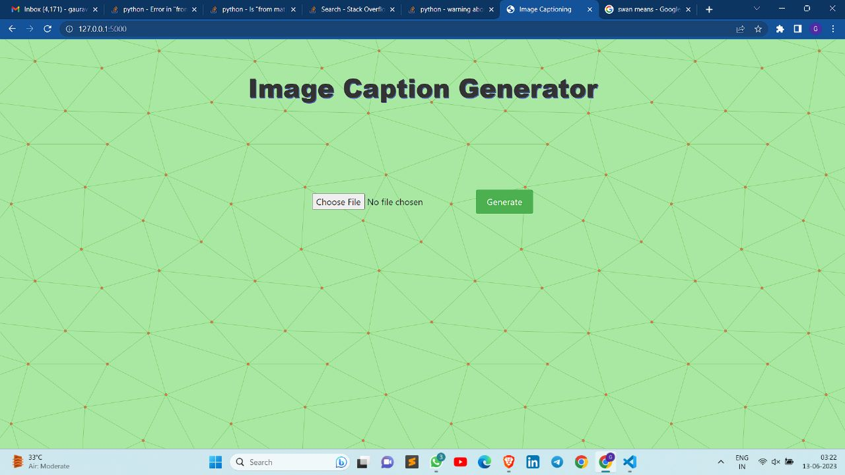
Flow of the Web-Application

Slide 15
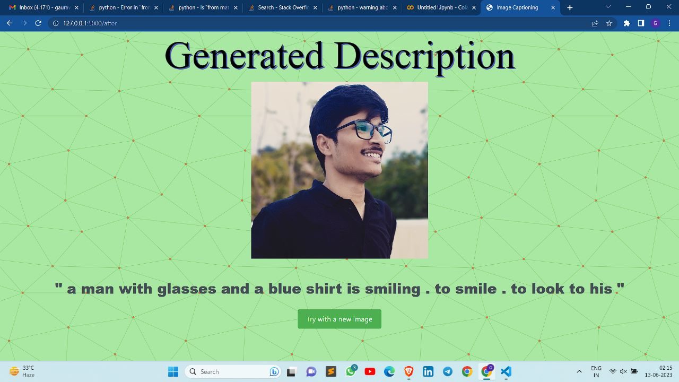
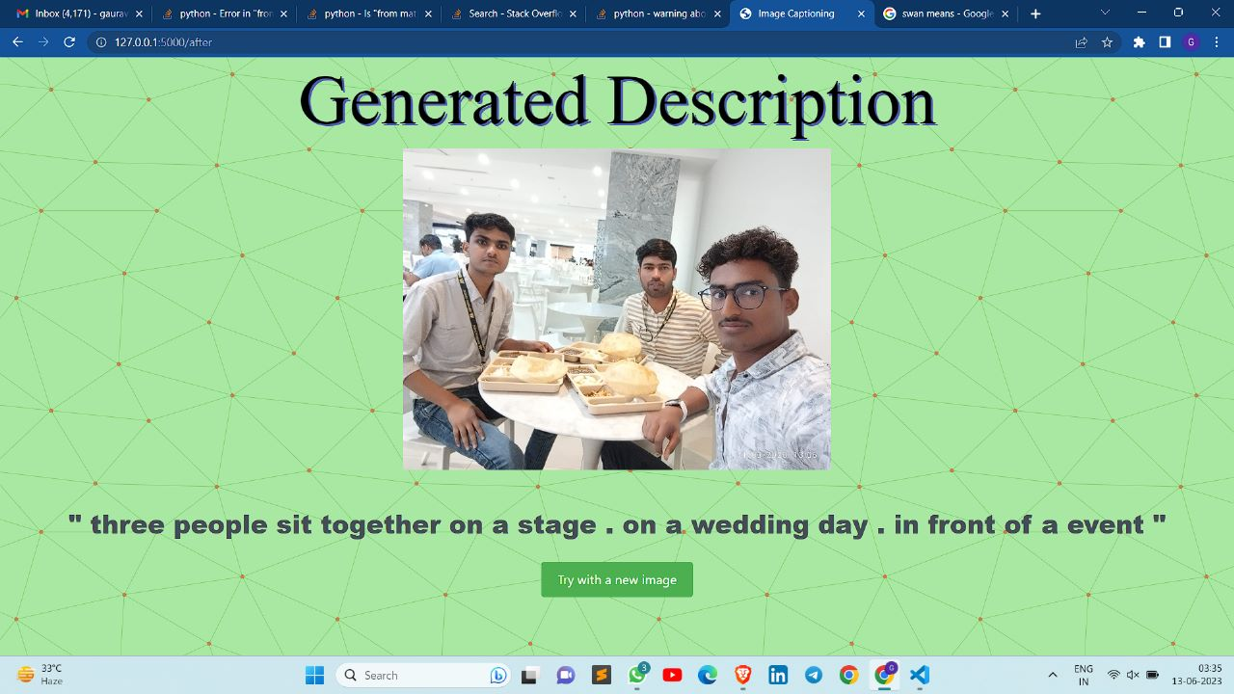
Live Demo Results

Slide 16
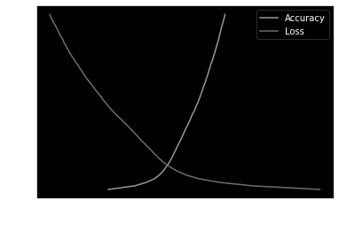
Analysis
We trained our model on a dataset of around 16000 flickr images. Model training took about 16 hours. We were able to obtain an accuracy of about 60% for our model on training data.
Along Y-axis we have Number of epochs.
Along X-axis we have values for loss and accuracy. As we can see range of loss values is from [1,5) and of accuracy is of [0,1), we have standardised the value points for loss in range to [0,1] using Normalization.
From the graph, we can see that initially accuracy increased exponentially but as epochs increased rate of increase in accuracy decreased and ended at about 59.8%. Whereas loss valued decreased with increase in number of epochs.

Slide 17
Plan of Work
Timeline of our Project :-
 | Aug 2022 | Sep 2022 | Oct 2022 | Nov 2022 | Dec 2022 | Jan 2023 | Feb 2023 | Mar 2023 | Apr 2023 | May2023
Topic Select
Documentation
Technology review
Implementation
Testing and debugging
Deployment

Slide 18
Conclusion
Image caption generators have transformed how computers understand and describe images. They generate captions that help with accessibility, understanding content, and organizing images. Advancements in deep learning and attention mechanisms make them better at accurately describing images in context. While challenges exist, exploring additional knowledge and using different approaches offer exciting possibilities. In conclusion, image caption generators bridge the gap between visuals and language, making content more accessible and discoverable, with great potential for future advancements.

Slide 19
References
Shuang Liu, Liang Bai,a, Yanli Hu and Haoran Wang. Image Captioning Based on Deep Neural Networks. EITCE (2018).
Lakshminarasimhan Srinivasan, Dinesh Sreekanthan, Amutha A.L. 12T: Image Captioning - A Deep Learning Approach (2018).
Simao Herdade, Armin Kappeler, Kofi Boakye, Joao Soares.Image Captioning: Transforming Objects into Words. San Francisco, CA (2019).
Aishwarya Maroju,Sneha Sri Doma Lahari Chandarlapati, Image Caption Generating Deep Learning Model,J.N.T.U, Hyderabad, Sreenidhi Institute of Science And Technology (2021).
Zhongliang Yang, Yu-Jin Zhang, Sadaqat ur Rehman, Yongfeng Huang: Image Captioning with Object Detection and Localization, Department of Electronic Engineering, Tsinghua University, Beijing 100084, China.

Slide 20
Thank You

